Slide 1
Specialization module “Transboundary Ecosystem Management and Conflict Prevention”
DAAD project: The Balkan Green Belt - a learning site for transboundary nature conservation and sustainable regional development
Content: CMP Open Standards for the Practice of Conservation. Short: Conservation Standards (CS)
Time: 25. August – 3. September 2022, + two online sessions á 3 hours the week before
Location: Sharr/Sar-Korab-Koritnik mountain region, Kosovo / Albania / Northern Macedonia
Participating universities: University of Tirana (Albania), University of Prishtina (Kosovo), University of Donja Gorica (Montenegro), University of Ioannina (Greece), Eberswalde University for Sustainable Development (Germany)
Module responsible: Prof. Dr. Pierre Ibisch
Lecturers: CS Coaches/CCNet Europe
Available places: 4 students from each partnering university
ECTS-Credits: 6
Costs covered: Food, accommodation, travel
Application procedure: Motivation letter, CV
Organisation and contact: jkloiber@hnee.de (in Ioannina jhalley@uoi.gr)

Slide 2
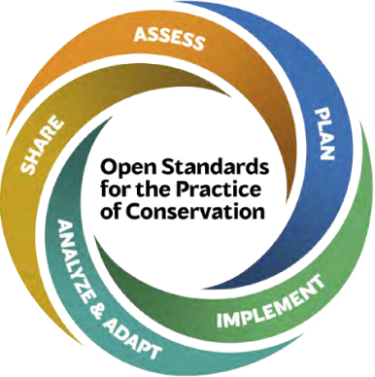
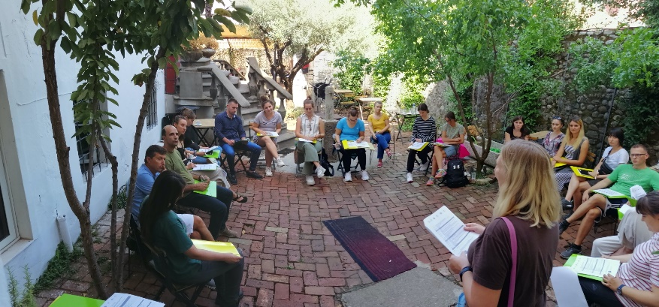
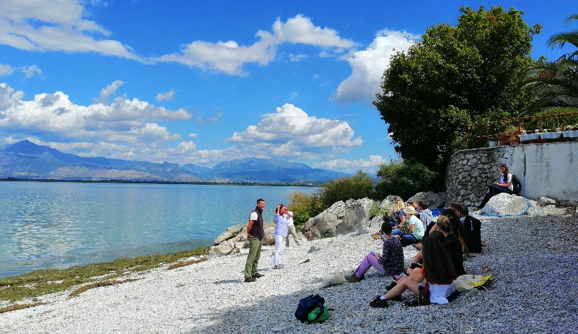
Specialization module “Transboundary Ecosystem Management and Conflict Prevention”
Format:
Theoretical lectures
Assisted group work
Excursions to case study area
Interviews with local stakeholders
Peer reviews
Topics:
Transboundary ecosystem management
Ecosystem-based development
Strategic conservation planning
Goal: Developing an initial transboundary management plan for the case study area.
Tools:
Conservation Measure Partnership (CMP)
Open Standards for the Practice of Conservation 4.0 (CS)
Organisation and contact: jkloiber@hnee.de
Photos: Judith Kloiber

